Slide 1
Chapter 13: Direct Memory Access and DMA-Controlled I/O

Slide 2
Introduction
The DMA I/O technique provides direct access to the memory while the microprocessor is temporarily disabled.
This chapter also explains the operation of disk memory systems and video systems that are often DMA-processed.
Disk memory includes floppy, fixed, and optical disk storage. Video systems include digital and analog monitors.

Slide 3
13–1 BASIC DMA OPERATION
Two control signals are used to request and acknowledge a direct memory access (DMA) transfer in the microprocessor-based system.
  the HOLD pin is an input used to request a
  DMA action
  the HLDA pin is an output that acknowledges
  the DMA action
Figure 13–1 shows the timing that is typically found on these two DMA control pins.

Slide 4
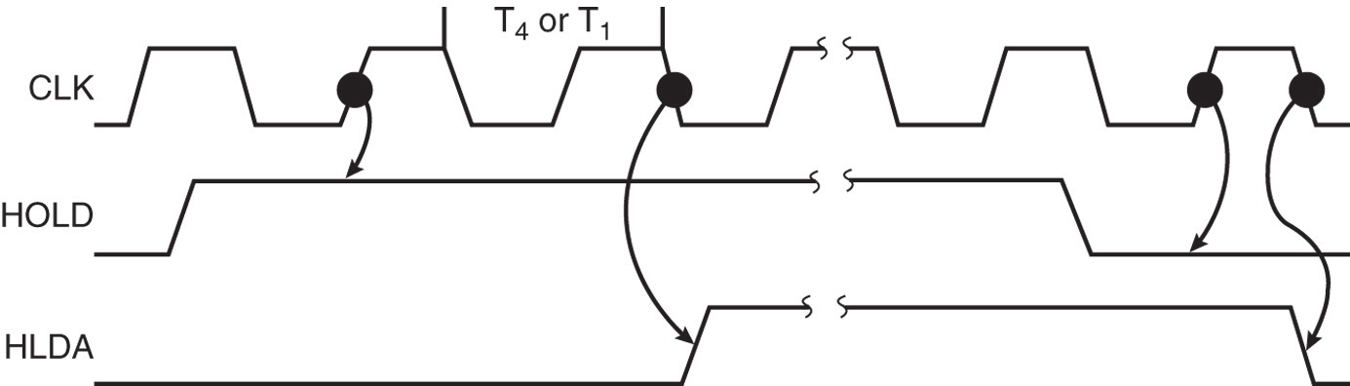
Figure 13–1 HOLD and HLDA timing for the microprocessor.
  HOLD is sampled in any clocking cycle
  when the processor recognizes the hold, it stops executing software and enters hold cycles
  HOLD input has higher priority than INTR or NMI
  the only microprocessor pin that has a higher priority than a HOLD is the RESET pin

Slide 5
HLDA becomes active to indicate the processor has placed its buses at high-impedance state.
  as can be seen in the timing diagram, there are
  a few clock cycles between the time that HOLD changes and until HLDA changes
HLDA output is a signal to the requesting device that the processor has relinquished control of its memory and I/O space.
  one could call HOLD input a DMA request
  input and HLDA output a DMA grant signal

Slide 6
Basic DMA Definitions
Direct memory accesses normally occur between an I/O device and memory without the use of the microprocessor.
  a DMA read transfers data from the memory
  to the I/O device
  A DMA write transfers data from an I/O device
  to memory
Memory & I/O are controlled simultaneously.
  which is why the system contains separate memory and I/O control signals

Slide 7
A DMA read causes the MRDC and IOWC signals to activate simultaneously.
  transferring data from memory to the I/O device
A DMA write causes the MWTC and IORC signals to both activate.
8086/8088 require a controller or circuit such as shown in Fig 13–2 for control bus signal generation.
The DMA controller provides memory with its address, and controller signal (DACK) selects the I/O device during the transfer.

Slide 8
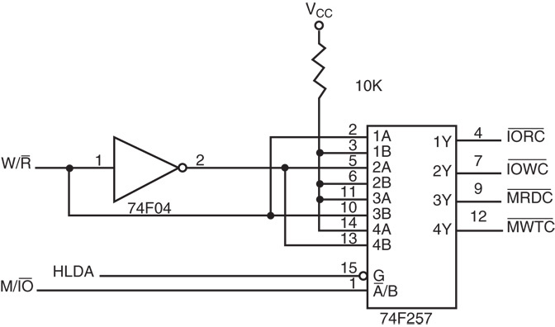
Figure 13–2 A circuit that generates system control signals in a DMA environment.

Slide 9
Data transfer speed is determined by speed of the memory device or a DMA controller.
  if memory speed is 50 ns, DMA transfers occur
  at rates up to 1/50 ns or 20 M bytes per second
  if the DMA controller functions at a maximum
  rate of 15 MHz with 50 ns memory, maximum transfer rate is 15 MHz because the DMA controller is slower than the memory
In many cases, the DMA controller slows the speed of the system when transfers occur.

Slide 10
The switch to serial data transfers in modern systems has made DMA is less important.
The serial PCI Express bus transfers data at rates exceeding DMA transfers.
The SATA (serial ATA) interface for disk drives uses serial transfers at the rate of 300 Mbps
  and has replaced DMA transfers for hard disks
Serial transfers on main-boards between components using can approach 20 Gbps
for the PCI Express connection.

Slide 11
13–2 THE 8237 DMA CONTROLLER
The 8237 supplies memory & I/O with control signals and memory address information during the DMA transfer.
  actually a special-purpose microprocessor
  whose job is high-speed data transfer between memory and I/O
Figure 13–3 shows the pin-out and block diagram of the 8237 programmable DMA controller.

Slide 12
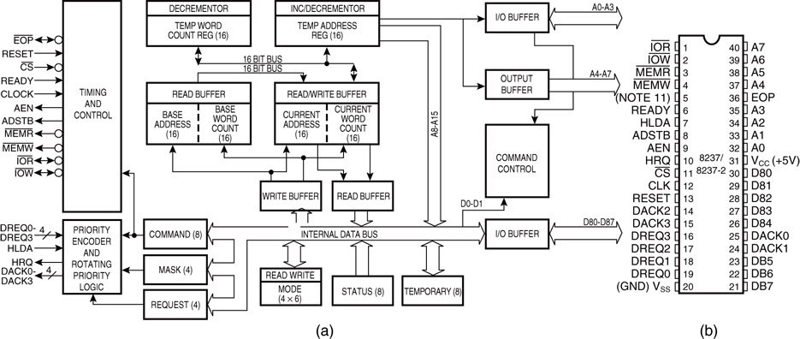
Figure 13–3 The 8237A-5 programmable DMA controller. (a) Block diagram and (b) pin-out. (Courtesy of Intel Corporation.)

Slide 13
8237 is not a discrete component in modern microprocessor-based systems.
  it appears within many system controller chip sets
8237 is a four-channel device compatible
with 8086/8088, adequate for small systems.
  expandable to any number of DMA channel inputs
8237 is capable of DMA transfers at rates up to 1.6M bytes per second.
  each channel is capable of addressing a full
  64K-byte section of memory and transfer up to 64K bytes with a single programming

Slide 14
8237 Pin Definitions
CLK
Clock input is connected to the system clock signal as long as that signal is 5 MHz or less.
  in the 8086/8088 system, the clock must be inverted for the proper operation of the 8237

Slide 15
8237 Pin Definitions
CS
Chip select enables 8237 for programming.
The CS pin is normally connected to the output of a decoder.
The decoder does not use the 8086/8088 control signal IO/M(M/IO) because it
contains the new memory and I/O control signals (MEMR, MEMW, IOR and IOW).

Slide 16
8237 Pin Definitions
RESET
The reset pin clears the command, status, request, and temporary registers.
It also clears the first/last flip-flop and sets
the mask register.
  this input primes the 8237 so it is disabled
  until programmed otherwise

Slide 17
8237 Pin Definitions
READY
A logic 0 on the ready input causes the
8237 to enter wait states for slower
memory components.
HLDA
A hold acknowledge signals 8237 that the microprocessor has relinquished control of
the address, data, and control buses.

Slide 18
8237 Pin Definitions
DREQ₀–DREQ₃
DMA request inputs are used to request a transfer for each of the four DMA channels.
  the polarity of these inputs is programmable, so
  they are either active-high or active-low inputs
DB₀–DB₇
Data bus pins are connected to the processor data bus connections and used during the programming of the DMA controller.

Slide 19
8237 Pin Definitions
IOR
I/O read is a bidirectional pin used during programming and during a DMA write cycle.
IOW
I/O write is a bidirectional pin used during programming and during a DMA read cycle.

Slide 20
8237 Pin Definitions
EOP
End-of-process is a bidirectional signal
used as an input to terminate a DMA
process or as an output to signal the
end of the DMA transfer.
  often used to interrupt a DMA transfer at
  the end of a DMA cycle

Slide 21
8237 Pin Definitions
A₀–A₃
These address pins select an internal
register during programming and provide
part of the DMA transfer address during a DMA action.
  address pins are outputs that provide part of
  the DMA transfer address during a DMA action

Slide 22
8237 Pin Definitions
HRQ
Hold request is an output that connects to
the HOLD input of the microprocessor in
order to request a DMA transfer.

Slide 23
8237 Pin Definitions
DACK₀–DACK₃
DMA channel acknowledge outputs acknowledge a channel DMA request.
These outputs are programmable as either active-high or active-low signals.
  DACK outputs are often used to select the
  DMA- controlled I/O device during the DMA transfer.

Slide 24
8237 Pin Definitions
AEN
Address enable signal enables the DMA address latch connected to the DB₇–DB₀
pins on the 8237.
  also used to disable any buffers in the
  system connected to the microprocessor

Slide 25
8237 Pin Definitions
ADSTB
Address strobe functions as ALE, except
it is used by the DMA controller to latch
address bits A₁₅–A₈ during the DMA transfer.
MEMR
Memory read is an output that causes memory to read data during a DMA read cycle.

Slide 26
8237 Pin Definitions
MEMW
Memory write is an output that causes memory to write data during a DMA write cycle.

Slide 27
8237 Internal Registers
CAR
The current address register holds a 16-bit memory address used for the DMA transfer.
  each channel has its own current address
  register for this purpose
When a byte of data is transferred during a DMA operation, CAR is either incremented
or decremented.
  depending on how it is programmed

Slide 28
8237 Internal Registers
CWCR
The current word count register programs
a channel for the number of bytes (up to 64K) transferred during a DMA action.
The number loaded into this register is one less than the number of bytes transferred.
  for example, if a 10 is loaded to CWCR, then
  11 bytes are transferred during the DMA action

Slide 29
8237 Internal Registers
BA and BWC
The base address (BA) and base word count (BWC) registers are used when
auto-initialization is selected for a channel.
In auto-initialization mode, these registers
are used to reload the CAR and CWCR
after the DMA action is completed.
  allows the same count and address to be used
  to transfer data from the same memory area

Slide 30
8237 Internal Registers
CR
The command register programs the operation of the 8237 DMA controller.
The register uses bit position 0 to select the memory-to-memory DMA transfer mode.
  memory-to-memory DMA transfers use DMA channel 0 to hold the source address
  DMA channel 1 holds the destination address
Similar to operation of a MOVSB instruction.

Slide 31
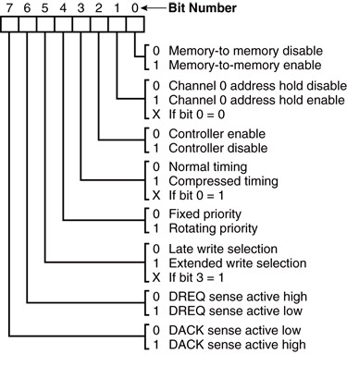
Figure 13–4 8237A-5 command register. (Courtesy of Intel Corporation.)

Slide 32
8237 Internal Registers
MR
The mode register programs the mode of operation for a channel.
Each channel has its own mode register as selected by bit positions 1 and 0.
  remaining bits of the mode register
  select operation, auto-initialization,
  increment/decrement, and mode for
  the channel

Slide 33
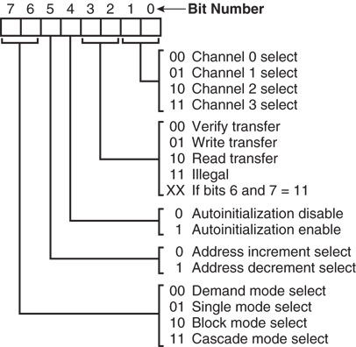
Figure 13–5 8237A-5 mode register. (Courtesy of Intel Corporation.)

Slide 34
8237 Internal Registers
BR
The bus request register is used to request
a DMA transfer via software.
  very useful in memory-to-memory transfers,
  where an external signal is not available to
  begin the DMA transfer

Slide 35
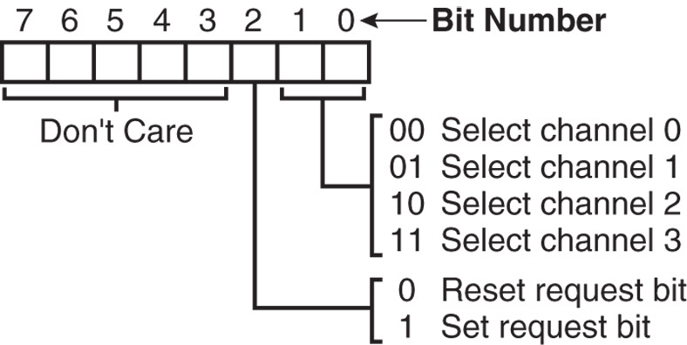
Figure 13–6 8237A-5 request register. (Courtesy of Intel Corporation.)

Slide 36
8237 Internal Registers
MRSR
The mask register set/reset sets or clears the channel mask.
  if the mask is set, the channel is disabled
  the RESET signal sets all channel masks
  to disable them

Slide 37
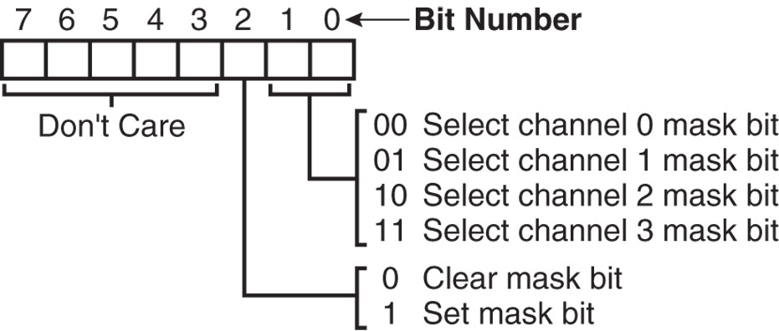
Figure 13–7 8237A-5 mask register set/reset mode. (Courtesy of Intel Corporation.)

Slide 38
8237 Internal Registers
MSR
The mask register clears or sets all of
the masks with one command instead of individual channels, as with the MRSR.

Slide 39
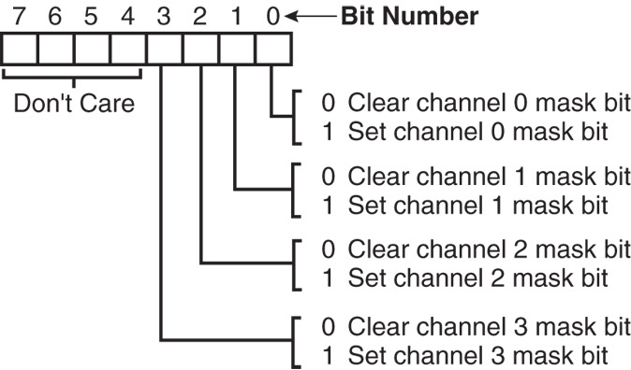
Figure 13–8 8237A-5 mask register. (Courtesy of Intel Corporation.)

Slide 40
8237 Internal Registers
SR
The status register shows status of each DMA channel. The TC bits indicate if the channel has reached its terminal count (transferred all its bytes).
When the terminal count is reached, the
DMA transfer is terminated for most modes
of operation.
  the request bits indicate whether the DREQ
  input for a given channel is active

Slide 41
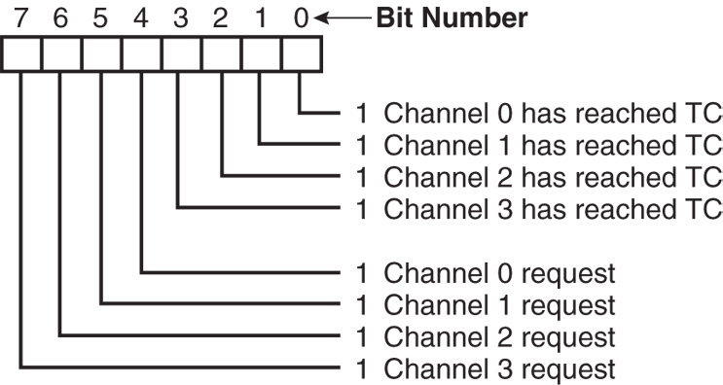
Figure 13–9 8237A-5 status register. (Courtesy of Intel Corporation.)

Slide 42
Software Commands
Three software commands are used to
control the operation of the 8237.
These commands do not have a binary bit pattern, as do various control registers
within the 8237.
  a simple output to the correct port number
  enables the software command
Fig 13–10 shows I/O port assignments that access all registers and the software commands.

Slide 43
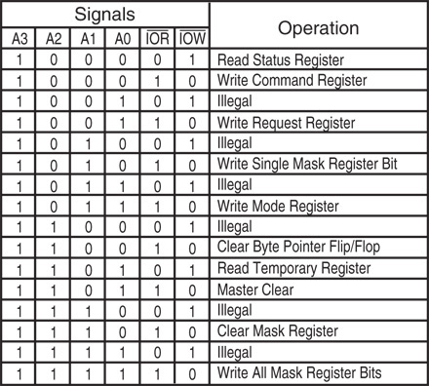
Figure 13–10 8237A-5 command and control port assignments. (Courtesy of Intel Corporation.)

Slide 44
8237 Software Commands
Master clear
Acts exactly the same as the RESET signal
to the 8237.
  as with the RESET signal, this command
  disables all channels
Clear mask register
Enables all four DMA channels.

Slide 45
8237 Software Commands
Clear the first/last flip-flop
Clears the first/last (F/L) flip-flop within 8237.
The F/L flip-flop selects which byte (low or high order) is read/written in the current address and current count registers.
  if F/L = 0, the low-order byte is selected
  if F/L = 1, the high-order byte is selected
Any read or write to the address or count register automatically toggles the F/L flip-flop.

Slide 46
Programming the Address and Count Registers
Figure 13–11 shows I/O port locations for programming the count and address
registers for each channel.
The state of the F/L flip-flop determines whether the LSB or MSB is programmed.
  if the state is unknown, count and address
  could be programmed incorrectly
It is important to disable the DMA channel before address and count are programmed.

Slide 47
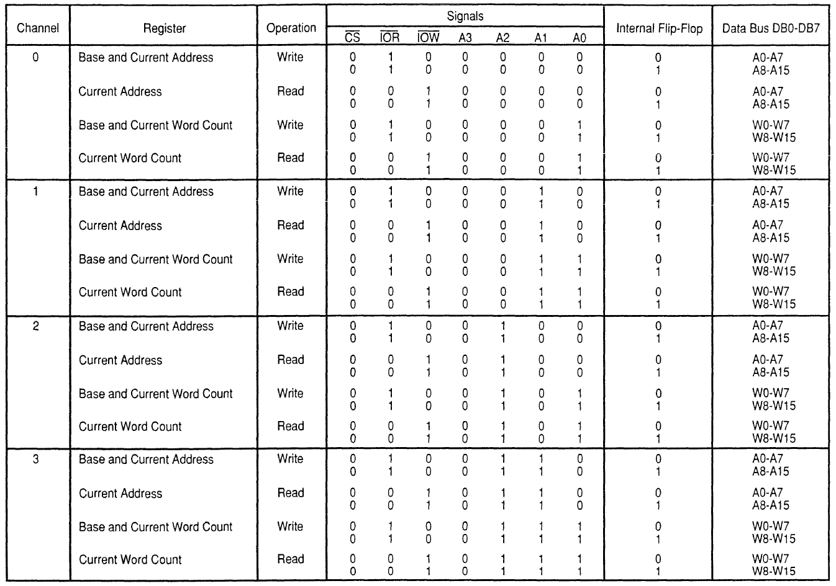
Figure 13–11 8237A-5 DMA channel I/O port addresses. (Courtesy of Intel)

Slide 48
Four steps are required to program the 8237:
  (1) The F/L flip-flop is cleared using a clear F/L command
  (2) the channel is disabled
  (3) LSB & MSB of the address are programmed
  (4) LSB & MSB of the count are programmed
Once these four operations are performed, the channel is programmed and ready to use.
  additional programming is required to select
  the mode of operation before the channel is enabled and started

Slide 49
The 8237 Connected to the 80X86
The address enable (AEN) output of 8237 controls the output pins of the latches and outputs of the 74LS257 (E).
  during normal operation (AEN=0), latches
  A & C and the multiplexer (E) provide address
  bus bits A₁₉–A₁₆ and A₇–A₀
See Figure 13-12.

Slide 50
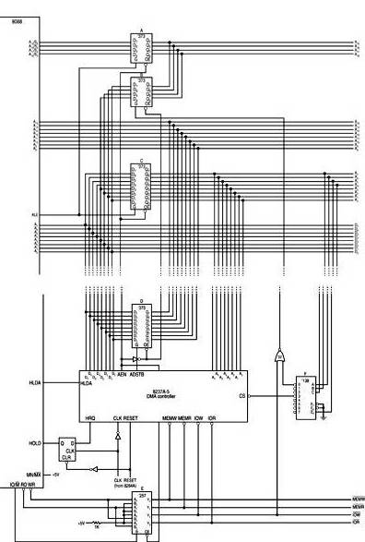
Figure 13–12 Complete 8088 minimum mode DMA system.

Slide 51
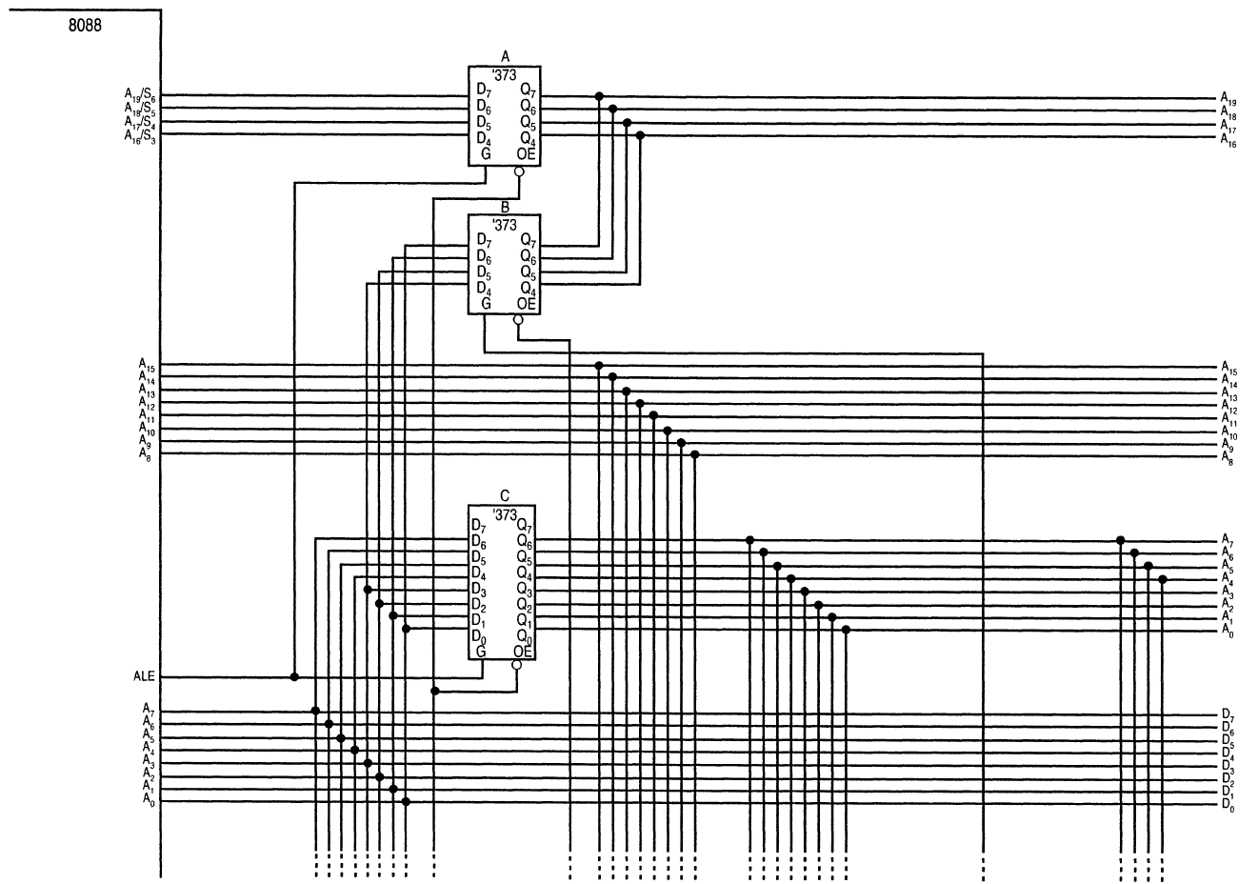

Slide 52
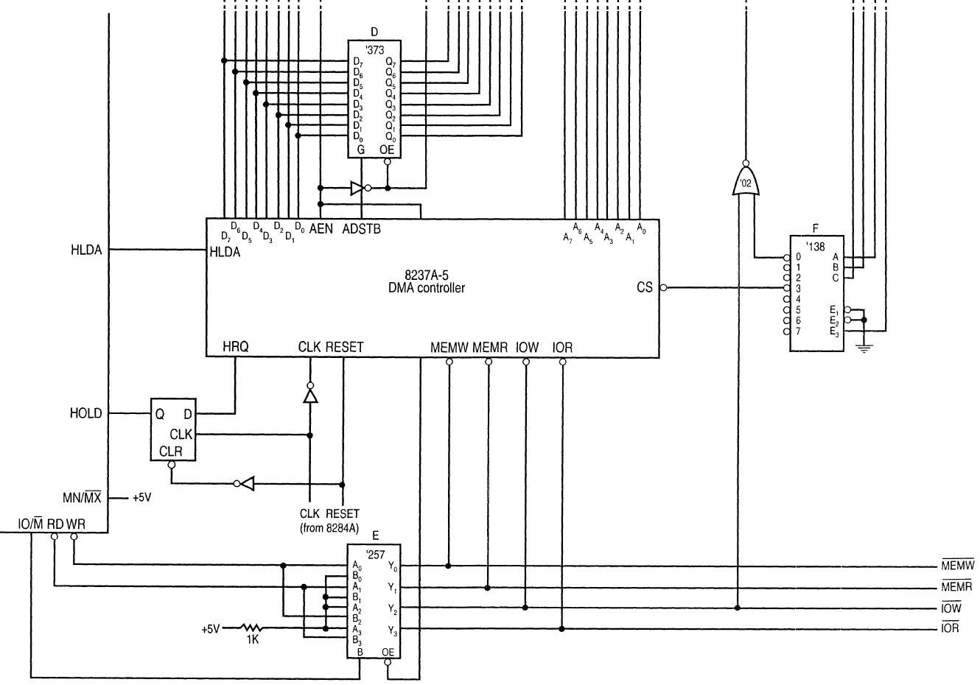

Slide 53
The multiplexer provides the system control signals as long as the 80X86 is in control of the system.
  during a DMA action (AEN=1), latches A & C
  are disabled along with the multiplexer (E)
  latches D and B now provide address bits
  A₁₉–A₁₆ and A₁₅–A₈
Address bus bits A₇–A₀ are provided directly by the 8237 and contain part of the DMA transfer address.
The DMA controller provides conntrol signals.

Slide 54
Memory-to-Memory Transfer with the 8237
Memory-to-memory transfer is much more powerful than the automatically repeated MOVSB instruction.
  most modern chip sets do not support the memory-to-memory feature
8237 requires only 2.0 µs per byte, which is over twice as fast as a software data transfer.
This is not true if an 80386, 80846, or Pentium is in use in the system.

Slide 55
Sample Memory-to-Memory DMA Transfer
Suppose contents of memory locations 10000H–13FFFH are to be transferred to locations 14000H–17FFFH.
  accomplished with a repeated string move instruction or with the DMA controller
Example 13–1 shows the software required
to initialize the 8237 and program latch B in Figure 13–12 for this DMA transfer.

Slide 56
Sample Memory Fill Using the 8237
To fill an area of memory with the same data, the channel 0 source register is programmed to point to the same address throughout the transfer.
  accomplished with the channel 0 hold mode
The controller copies the contents of this single memory location to an entire block
of memory addressed by channel 1.
This has many useful applications.

Slide 57
DMA-Processed Printer Interface
Fig 13–13 illustrates the hardware added
to Fig13–12 for a DMA-controlled printer interface.
  software to control this interface is simple as
  only the address of the data and number of characters to be printed are programmed
Once programmed, the channel is enabled, and the DMA action transfers a byte at a
time to the printer interface.
  each time a printer ACK signal is received

Slide 58
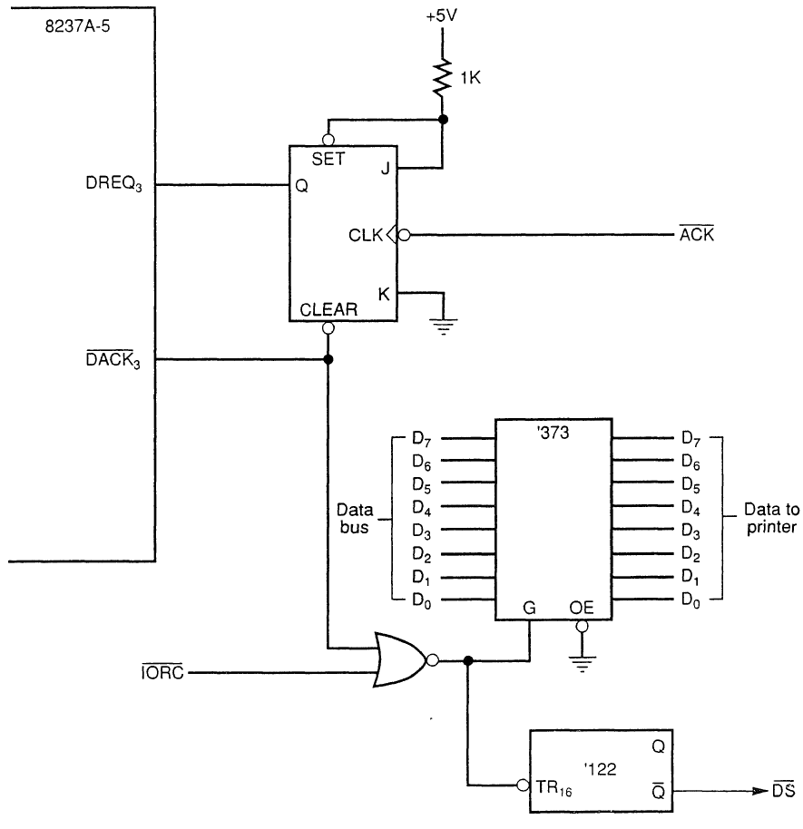
Figure 13–13 DMA-processed printer interface.

